Slide 1
Azure - Day 3 Epam DevOps School
Azure Web Apps
Azure SQL
Azure Key Vault
Azure Cosmos DB
CONFIDENTIAL | © 2020 EPAM Systems, Inc.

Slide 2
Part 01: Azure Web Apps

Slide 3
App Service
Service for hosting web applications, REST APIs, and mobile backends can be developed in many of the following languages:
Applications can execute and scale in a fully managed, sandbox environment
.NET
.NET Core
Java
Ruby
Node.JS
PHP
Python
Notes:
Azure App Service not only adds the power of Microsoft Azure to your application, such as security, load balancing, autoscaling, and automated management. You can also take advantage of its DevOps capabilities, such as continuous deployment from VSTS, GitHub, Docker Hub, and other sources; and package management, staging environments, custom domain, and SSL certificates.
With App Service, you pay for the Azure compute resources that you use. The compute resources you use is determined by the App Service plan that you run your apps on.

Slide 4
Web Apps
Scalable hosting for web applications
Provides a quick way to host your web application in the cloud
Allows you to scale your web app without being required to redesign for scalability
Integrates with Visual Studio
Provides an open platform for many different programming languages
Advantages
Near instant deployment
SSL and Custom Domain Names available in some tiers
WebJobs provide background processing for independent scaling
Can scale to larger machines without redeploying applications
Notes:
Azure App Service Web Apps (or just Web Apps) is a service for hosting web applications, REST APIs, and mobile backends. You can develop in your favorite language, be it .NET, .NET Core, Java, Ruby, Node.js, PHP, or Python. Applications run and scale with ease on Windows-based environments.

Slide 5
Key features of App Service Web Apps
Multiple languages and frameworks
First-class support for ASP.NET , ASP.NET Core, Java, Ruby, Node.js, PHP, or Python
DevOps optimization
Continuous integration and deployment with Visual Studio Team Services, GitHub, Bitbucket, Docker Hub, or Azure Container Registry
Global scale with high availability
Scale up or out manually or automatically. Host anywhere in the Microsoft global datacenter infrastructure
Connections to SaaS platforms and on-premises data
More than 50 connectors for enterprise systems (such as SAP), SaaS services (such as Salesforce), and internet services (such as Facebook)
Notes:
Multiple languages and frameworks
Web Apps has first-class support for ASP.NET , ASP.NET Core, Java, Ruby, Node.js, PHP, or Python. You can also run PowerShell and other scripts or executables as background services.
DevOps optimization
Set up continuous integration and deployment with Visual Studio Team Services, GitHub, BitBucket, Docker Hub, or Azure Container Registry. Promote updates through test and staging environments. Manage your apps in Web Apps by using Azure PowerShell or the cross-platform command-line interface (CLI).
Global scale with high availability
Scale up or out manually or automatically. Host your apps anywhere in Microsoft's global datacenter infrastructure, and the App Service SLA promises high availability.
Connections to SaaS platforms and on-premises data
Choose from more than 50 connectors for enterprise systems (such as SAP), SaaS services (such as Salesforce), and internet services (such as Facebook). Access on-premises data using Hybrid Connections and Azure Virtual Networks.

Slide 6
Key features of App Service Web Apps (cont.)
Security and compliance
App Service is ISO, SOC, and PCI compliant
Application templates
Templates in the Azure Marketplace, such as WordPress, Joomla, and Drupal
Visual Studio integration
Streamline the work of creating, deploying, and debugging
API and mobile features
Turn-key Cross-Origin Resource Sharing (CORS) support for RESTful API scenarios, and enables authentication, offline data sync, push notifications, and more
Serverless code
Run code on-demand without having to explicitly provision or manage infrastructure
Notes:
Security and compliance
App Service is ISO, SOC, and PCI compliant. Authenticate users with Azure Active Directory or with social login (Google, Facebook, Twitter, and Microsoft). Create IP address restrictions and manage service identities.
Application templates
Choose from an extensive list of application templates in the Azure Marketplace, such as WordPress, Joomla, and Drupal.
Visual Studio integration
Dedicated tools in Visual Studio streamline the work of creating, deploying, and debugging.
API and mobile features
Web Apps provides turnkey CORS support for RESTful API scenarios, and simplifies mobile app scenarios by enabling authentication, offline data sync, push notifications, and more.
Serverless code
Run a code snippet or script on-demand without having to explicitly provision or manage infrastructure, and pay only for the compute time your code actually uses.

Slide 7
App Service plans
App Service plans can logically group apps within a subscription:
Characteristics such as features, capacity, and tiers are shared among the website instance in the group
The App Service plan is the unit of billing in most cases
Multiple App Service plans can exist in a single Resource Group and multiple apps can exist in a single App Service plan
Notes:
In App Service, an app runs in an App Service plan. An App Service plan defines a set of compute resources for a web app to run. These compute resources are analogous to the server farm in conventional web hosting. One or more apps can be configured to run on the same computing resources (or in the same App Service plan).
When you create an App Service plan in a certain region (for example, West Europe), a set of compute resources is created for that plan in that region. Whatever apps you put into this App Service plan run on these compute resources as defined by your App Service plan.

Slide 8
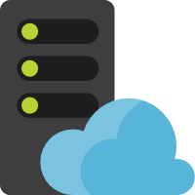

App Service plans (continued)
Web app
App Service plan
Web app
Web app
Notes:
Because you pay for the computing resources your App Service plan allocates, you can potentially save money by putting multiple apps into one App Service plan. You can continue to add apps to an existing plan as long as the plan has enough resources to handle the load. However, keep in mind that all the apps in an App Service plan share the same compute resources. To determine whether the new app has the necessary resources, you must understand the capacity of the existing App Service plan, and the expected load for the new app. Overloading an App Service plan can potentially cause downtime for your new and existing apps.

Slide 9
Authentication and authorization
Built-in authentication and authorization support
No extra code required to make use of these features
User claims are made available to code
If you wish to enhance the authentication support, you can use your existing code with popular identity frameworks:
ASP.NET Identity
PHP server variables
Built-in token store
Logging and tracing enabled for authentication events
Support for popular identity providers
Azure Active Directory (Azure AD), Microsoft accounts, Facebook, Google, Twitter, more…
Notes:
Azure App Service provides built-in authentication and authorization support, so you can sign in users and access data by writing minimal or no code in your web app, API, and mobile backend, and also Azure Functions.
For all language frameworks, App Service makes the user's claims available to your code by injecting them into the request headers. For ASP.NET 4.6 apps, App Service populates ClaimsPrincipal.Current with the authenticated user's claims, so you can follow the standard .NET code pattern, including the [Authorize] attribute. Similarly, for PHP apps, App Service populates the _SERVER['REMOTE_USER'] variable.
App Service provides a built-in token store, which is a repository of tokens that are associated with the users of your web apps, APIs, or native mobile apps. When you enable authentication with any provider, this token store is immediately available to your app.
If you enable application logging, you will observe authentication and authorization traces directly in your log files. If you observe an authentication error that you didn’t expect, you can conveniently find all the details by examining your existing application logs. If you enable failed request tracing, you can review exactly what role the authentication and authorization module may have played in a failed request.
App Service uses federated identity, in which a third-party identity provider manages the user identities and authentication flow for you. Five identity providers are available by default:
Azure Active Directory /.auth/login/aad
Microsoft account /.auth/login/microsoftaccount
Facebook /.auth/login/facebook
Google /.auth/login/google
Twitter /.auth/login/twitter
When you enable authentication and authorization with one of these providers, its sign-in endpoint is available for user authentication and for validation of authentication tokens from the provider. You can provide your users with any number of these sign-in options with ease. You can also integrate another identity provider or your own custom identity solution.

Slide 10
OS and runtime patching
OS and application stack are managed by Azure on your behalf
Monthly OS patching
Physical servers
Guest virtual machines
Stable versions of application runtimes are periodically added to App Services
Some are installed side by side, while others replace existing versions
You can manually migrate from one application runtime to another
Notes:
App Service is a platform as a service (PaaS), which means that the OS and application stack are managed for you by Azure; you only manage your application and its data.
Azure manages OS patching on two levels, the physical servers and the guest virtual machines (VMs) that run the App Service resources. Both are updated monthly. These updates are applied automatically, in a way that guarantees the high availability SLA of Azure services.
New stable versions of supported language runtimes (major, minor, or patch) are periodically added to App Service instances. Some updates overwrite the existing installation, while others are installed side by side with existing versions. An overwrite installation means that your app automatically runs on the updated runtime. A side-by-side installation means you must manually migrate your app to take advantage of a new runtime version.

Slide 11
Updating app runtimes
az webapp config set --net-framework-version v4.7 --resource-group <groupname> --name <appname>
az webapp config set --php-version 7.0 --resource-group <groupname> --name <appname>
az webapp config set --python-version 3.4 --resource-group <groupname> --name <appname>
az webapp config set --resource-group <groupname> --name <appname> --java-version 1.8 --java-container Tomcat --java-container-version 9.0
Update .NET Version
Update PHP Version
Update Python Version
Update Java Version
Notes:
When a new major or minor version is added, it is installed side-by-side with the existing versions. You can manually upgrade your app to the new version. If you configured the runtime version in a configuration file (such as web.config and package.json), you need to upgrade with the same method. If you used an App Service setting to configure your runtime version, you can change it in the Azure portal or by running an Azure CLI command in the Cloud Shell.
To update the application runtime, use the az webapp config set command with the appropriate parameter for your runtime.

Slide 12
Updating app runtimes (Node.js)
az webapp config appsettings set `
--resource-group <groupname> `
--name <appname> `
--settings WEBSITE_NODE_DEFAULT_VERSION=8.9.3
Notes:
Web Apps does not have a built-in mechanism to update Node.js runtimes. Instead, you can use the az webapp config appsettings set command to change the WEBSITE_NODE_DEFAULT_VERSION application setting to the version of Node.js that you wish to use.

Slide 13
Inbound and outbound IP addresses
Each app has a single inbound IP address
Regardless of scale-out quantity
Inbound IP address can change
Delete an app and re-create it in a new resource group
Delete the last app in a resource group + region combination and re-create it
Delete an existing SSL binding
You can opt to use a state inbound IP
Each app has a set number of outbound IP addresses
The set and quantity changes as you scale your app between tiers
Notes:
Azure App Service is a multi-tenant service. Apps share network infrastructure with other apps. As a result, the inbound and outbound IP addresses of an app can be different, and can even change in certain situations.
Regardless of the number of scaled-out instances, each app has a single inbound IP address. The inbound IP address might change when you perform one of the following actions:
Delete an app and recreate it in a different resource group.
Delete the last app in a resource group and region combination and recreate it.
Delete an existing SSL binding, such as during certificate renewal.
Sometimes you might want a dedicated, static IP address for your app. To get a static inbound IP address, you need to configure an IP-based SSL binding. If you don't actually need SSL functionality to secure your app, you can even upload a self-signed certificate for this binding. In an IP-based SSL binding, the certificate is bound to the IP address itself, so App Service provisions a static IP address to make it happen.
Regardless of the number of scaled-out instances, each app has a set number of outbound IP addresses at any given time. Any outbound connection from the App Service app, such as to a back-end database, uses one of the outbound IP addresses as the origin IP address. You can't know beforehand which IP address a given app instance will use to make the outbound connection, so your back-end service must open its firewall to all the outbound IP addresses of your app.
The set of outbound IP addresses for your app changes when you scale your app between the lower tiers (Basic, Standard, and Premium) and the Premium V2 tier.

Slide 14
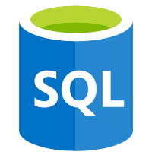

Outbound IP addresses
Web App instances
Inbound IP
Outbound IPs
Azure SQL Database
Azure Storage
Notes:
Regardless of the number of scaled-out instances, each app has a set number of outbound IP addresses at any given time. Any outbound connection from the App Service app, such as a connection to a back-end database, uses one of the outbound IP addresses as the origin IP address.
You can't know beforehand which IP address a given app instance will use to make the outbound connection. Therefore, your back-end service must open its firewall to all the outbound IP addresses of your app.

Slide 15
When IP addresses change
Inbound
When you delete an app and recreate it
When you delete the last app in a resource group
When you delete an existing SSL binding
Outbound
Why you scale from a lower tier (Basic, Standard, Premium) to the Premium V2 tier
Notes:
Regardless of the number of scaled-out instances, each app has a single inbound IP address.
The inbound IP address might change when you perform one of the following actions:
Delete an app and recreate it in a different resource group.
Delete the last app in a resource group and region combination and recreate it.
Delete an existing SSL binding, such as during certificate renewal
The set of outbound IP addresses for your app changes when you scale your app between the lower tiers (Basic, Standard, and Premium) and the Premium V2 tier.

Slide 16
Find outbound IP addresses
# find Outbound IP address
az webapp show --resource-group <group_name> --name <app_name> --query outboundIpAddresses --output tsv
# find all possible IP addresses (regardless of tier)
az webapp show --resource-group <group_name> --name <app_name> --query possibleOutboundIpAddresses --output tsv
Notes:
You can find the set of all possible outbound IP addresses your app can use, regardless of pricing tiers, by examining the possibleOutboundIPAddresses property.
You can find the same information by observing your app in the Azure portal. Select Properties in your app's left-hand navigation.

Slide 17
Azure App Service Hybrid Connections
Enables access to resources in other networks
Any operating system and any application
Hosted in other cloud networks, local networks, or even a specific machine
Correlates to a single TCP host and port combination
Service that is available in more than just App Service
Benefits:
Doesn’t require internet-facing endpoint
Web Apps can access on-premises systems securely
Does not require firewall changes in most scenarios
Framework and operating system agnostic
Notes:
Within App Service, Hybrid Connections can be used to access application resources in other networks. It provides access from your app to an application endpoint. It does not enable an alternate capability to access your application. As used in App Service, each Hybrid Connection correlates to a single TCP host and port combination. This means that the Hybrid Connection endpoint can be on any operating system and any application, provided you are accessing a TCP listening port. The Hybrid Connections feature does not know or care what the application protocol is, or what you are accessing. It is simply providing network access.
Hybrid Connections is both a service in Azure and a feature in Azure App Service. As a service, it has uses and capabilities beyond those that are used in App Service.
There are a number of benefits to the Hybrid Connections capability, including:
Apps can access on-premises systems and services securely.
The feature does not require an internet-accessible endpoint.
It is quick and easy to set up.
Each Hybrid Connection matches to a single host:port combination, which is helpful for security.
It normally does not require firewall holes. The connections are all outbound over standard web ports.
Because the feature is network level, it is agnostic to the language used by your app and the technology used by the endpoint.
It can be used to provide access in multiple networks from a single app.

Slide 18



Azure App Service Hybrid Connections example
Web App
Relay hybrid
connection
Hybrid
Connection
Manager
Endpoint
Notes:
The Hybrid Connections feature consists of two outbound calls to Azure Service Bus Relay. There is a connection from a library on the host where your app is running in App Service. There is also a connection from the Hybrid Connection Manager (HCM) to Service Bus Relay. The HCM is a relay service that you deploy within the network hosting the resource that you are trying to access.
Through the two joined connections, your app has a TCP tunnel to a fixed host:port combination on the other side of the HCM. The connection uses TLS 1.2 for security and shared access signature (SAS) keys for authentication and authorization.
When your app makes a DNS request that matches a configured Hybrid Connection endpoint, the outbound TCP traffic will be redirected through the Hybrid Connection.

Slide 19
Controlling traffic by using Azure Traffic Manager
Routes requests from clients to apps in Azure
Keeps track of app status (running, stopped, deleted)
Will automatically route traffic away from an unavailable app
Configured by using profiles
Stores the routing method for requests
Stores a list of endpoints (apps) to route requests to
Stores information about endpoint status
Notes:
You can use Azure Traffic Manager to control how requests from web clients are distributed to apps in Azure App Service. When App Service endpoints are added to an Azure Traffic Manager profile, Azure Traffic Manager keeps track of the status of your App Service apps (running, stopped, or deleted) so that it can decide which of those endpoints should receive traffic.
To configure the control of App Service app traffic, you create a profile in Azure Traffic Manager, and then add the endpoints (in this case, App Service) for which you want to control traffic to the profile. Your app status (running, stopped, or deleted) is regularly communicated to the profile so that Azure Traffic Manager can direct traffic accordingly.

Slide 20


Azure Traffic Manager and Web Apps
DNS
Azure Traffic Manager
Inbound IP
Notes:
You can use Azure Traffic Manager to control how requests from web clients are distributed to apps in Azure App Service.
Traffic Manager uses DNS to direct client requests to the most appropriate service endpoint based on a traffic-routing method and the health of the endpoints.

Slide 21
Azure Traffic Manager routing methods
Priority
Distribute users to a specific app
In case of failure, route users to backup apps based on a priority scheme
Weighted
Distribute traffic across apps according to weights that you define
Your weight definition could potentially distribute users evenly
Performance
Route users to the “closest” app location based on latency
Geographic
Route users to specific app locations based on their current location
Notes:
Priority
Use a primary app for all traffic, and provide backups in case the primary or the backup apps are unavailable.
Weighted
Distribute traffic across a set of apps, either evenly or according to weights, which you define.
Performance
When you have apps in different geographic locations, use the "closest" app in terms of the lowest network latency.
Geographic
Direct users to specific apps based on which geographic location their DNS query originates from.

Slide 22



Priority traffic-routing method
1
Recursive
DNS Service
User
Browser
DNS query
DNS response
2
4
3
Client connects directly
to selected endpoint,
not through Traffic Manager
Choose available endpoint
with highest priority
Traffic Manager
Endpoint | Priority | Status
Primary | 1 | Degraded
Failover A | 2 | Online
Failover B | 3 | Online
Health checks
Primary
Priority 1
Failover A
Priority 2
Failover B
Priority 3
Azure
Notes:
Often an organization wants to provide reliability for its services by deploying one or more backup services in case their primary service goes down. The priority traffic-routing method allows Azure customers to easily implement this failover pattern.
The Azure Traffic Manager profile contains a prioritized list of service endpoints. By default, Traffic Manager sends all traffic to the primary (highest-priority) endpoint. If the primary endpoint is not available, Traffic Manager routes the traffic to the second endpoint. If both the primary and secondary endpoints are not available, the traffic goes to the third, and so on. Availability of the endpoint is based on the configured status (enabled or disabled) and the ongoing endpoint monitoring.

Slide 23
Weighted traffic-routing method
1
Recursive
DNS Service
User
Browser
DNS query
DNS response
2
4
3
Client connects directly
to selected endpoint,
not through Traffic Manager
Choose available endpoint at
random, based on weights
Traffic Manager
Endpoint | Weight | Status
Primary | 50 | Degraded
Failover A | 5 | Online
Failover B | 50 | Online
Health checks
Region A
Weight 50
Test A
Weight 5
Region B
Weight 50
Azure
Notes:
The weighted traffic-routing method allows you to distribute traffic evenly or to use a pre-defined weighting. In the weighted traffic-routing method, you assign a weight to each endpoint in the Traffic Manager profile configuration. The weight is an integer from 1 to 1000. This parameter is optional. If omitted, Traffic Managers use a default weight of 1. The higher the weight, the higher the priority.
For each DNS query received, Traffic Manager randomly chooses an available endpoint. The probability of choosing an endpoint is based on the weights assigned to all available endpoints. Using the same weight across all endpoints results in an even traffic distribution. Using higher or lower weights on specific endpoints causes those endpoints to be returned frequently in the DNS responses.

Slide 24
Performance traffic-routing method
1
Recursive
DNS Service
User
Browser
DNS query
DNS response
2
Look up closest available endpoint in latency
table by using DNS query source IP address
4
3
IP Range | West US | North Europe | East Asia
… | … | … | …
89.17.0.0/16 | 15ms | 75ms | 150ms
… | … | … | …
Client connects directly
to selected endpoint,
not through Traffic Manager
Traffic Manager
Health checks
Endpoint 1
West US
Endpoint 2
North Europe
Endpoint 3
East Asia
Azure
Notes:
Deploying endpoints in two or more locations across the globe can improve the responsiveness of many applications by routing traffic to the location that is 'closest' to you. The performance traffic-routing method provides this capability.
The 'closest' endpoint is not necessarily closest as measured by geographic distance. Instead, the performance traffic-routing method determines the closest endpoint by measuring network latency. Traffic Manager maintains an internet latency table to track the round-trip time between IP address ranges and each Azure datacenter.
Traffic Manager looks up the source IP address of the incoming DNS request in the internet latency table. Traffic Manager then chooses an available endpoint in the Azure datacenter that has the lowest latency for that IP address range and returns that endpoint in the DNS response.

Slide 25
Geographic traffic-routing method
1
Recursive
DNS Service
User
Browser
DNS query
DNS response
Choose the endpoint that is designated to
serve the user’s geographic region, based on
the DNS query’s source IP address
4
Client connects directly
to selected endpoint,
not through Traffic Manager
3
2
Endpoint | Assigned Geo
Endpoint 1 | Germany
Nested Profile | Mexico, Asia
Endpoint 2 | World
Health Checks
Traffic Manager
Endpoint 1
[Germany]
Nested Profiles
[Mexico, Asia]
Endpoint 2
[World]
Endpoint A
Priority 1
Endpoint B
Priority 2
Azure
Notes:
You can configure Traffic Manager profiles to use the geographic routing method so that users are directed to specific endpoints (Azure, External, or Nested) based the geographic location from which their DNS query originates. When a profile is configured for geographic routing, each endpoint associated with that profile must have a set of geographic regions assigned to it.
A geographic region can be at following levels of granularity:
World, which means any region
Regional Grouping; for example, Africa, Middle East, or Australia/Pacific.
Country/Region; for example, Ireland, Peru, or Hong Kong SAR.
State/Province; for example, California in the USA, Queensland in Australia, or Alberta in Canada. Note that this granularity level is supported only for states or provinces in Australia, Canada, and the USA.
When you assign a region or a set of regions to an endpoint, any requests from those regions get routed only to that endpoint. Traffic Manager uses the source IP address of the DNS query to determine the region from which a user is querying. Usually, this is the IP address of the local DNS resolver doing the query on behalf of the user.

Slide 26
Azure App Service Local Cache
Provides a write-but-discard cache of your content
Created asynchronously when site is started
Automatically serves content once the cache is ready
Faster than reading content from Azure Storage directly on each client request
Notes:
Azure web app content is stored on Azure Storage and is surfaced up in a durable manner as a content share. This design is intended to work with a variety of apps and has the following attributes:
The content is shared across multiple virtual machine (VM) instances of the web app.
The content is durable and can be modified by running web apps.
Log files and diagnostic data files are available under the same shared content folder.
Publishing new content directly updates the content folder. You can immediately view the same content through the SCM website and the running web app (typically, some technologies such as ASP.NET do initiate a web app restart on some file changes to get the latest content).
While many web apps use one or all of these features, some web apps just need a high-performance, read-only content store that they can run from with high availability. These apps can benefit from a VM instance of a specific local cache.
The Azure App Service Local Cache feature provides a web role view of your content. This content is a write-but-discard cache of your storage content that is created asynchronously on-site startup. When the cache is ready, the site is switched to run against the cached content. Web Apps that run on Local Cache have the following benefits:
They are immune to latencies that occur when they access content on Azure Storage.
They are immune to the planned upgrades or unplanned downtimes and any other disruptions with Azure Storage that occur on servers that serve the content share.
They have fewer app restarts due to storage share changes.

Slide 27
App Service environments (ASEs)
App Service variant that provides a fully isolated and dedicated environment for securely running App Service apps at high scale
Ideal for application workloads that require:
Very high scale, higher than typical App Service capacity
Network isolation and secure network access
High memory utilization
Single or Multi-region
Deployed to a virtual network
An ASE is dedicated exclusively to a single subscription
Max 100 instances
Notes:
The Azure App Service Environment is an Azure App Service feature that provides a fully isolated and dedicated environment for securely running App Service apps at high scale. App Service environments (ASEs) are appropriate for application workloads that require:
Very high scale
Isolation and secure network access
High memory utilization
Customers can create multiple ASEs within a single Azure region or across multiple Azure regions. This flexibility makes ASEs ideal for horizontally scaling stateless application tiers in support of high Remote Powershell workloads.
ASEs are isolated to running only a single customer's applications and are always deployed into a virtual network. Customers have fine-grained control over inbound and outbound application network traffic. Applications can establish high-speed secure connections over virtual private networks (VPNs) to on-premises corporate resources.
An ASE is dedicated exclusively to a single subscription and can host 100 App Service plan instances. The range can span 100 instances in a single App Service plan to 100 single-instance App Service plans, and everything in between.
An ASE is composed of front ends and workers. Front ends are responsible for HTTP/HTTPS termination and automatic load balancing of app requests within an ASE. Front ends are automatically added as the App Service plans in the ASE are scaled out.

Slide 28
Creating a web app with Azure CLI (continued)
# generate a unique name and store as a shell variable
webappname=mywebapp$RANDOM
# create a resource group
az group create --location westeurope --name myResourceGroup
# create an App Service plan
az appservice plan create --name $webappname --resource-group myResourceGroup --sku FREE
# create a Web App
az webapp create --name $webappname `
--resource-group myResourceGroup `
--plan $webappname
https://mywebapp252247380.azurewebsites.net/
Notes:
Generate a random web app name.
Create a resource group.
Create a new App Service plan using the randomly generated web app name as the name of the plan and the FREE tier.
Create a new web app using the App Service plan created earlier and the randomly generated name.

Slide 29
Deploying a web app with Azure CLI
# store a repository url as a shell variable
gitrepo=https://github.com/Azure-Samples/php-docs-hello-world
# deploy code from a Git repository
az webapp deployment source config --name $webappname --resource-group myResourceGroup --repo-url $gitrepo --branch master --manual-integration
# print out the FQDN for the Web App
echo http://$webappname.azurewebsites.net
Notes:
Store a GitHub URL (URL for a publicly available Git repo).
Deploy code from the public URL by using the master branch to the web app created earlier.
Print out the fully qualified domain name (FQDN) by using string concatenation and the web app name variable.

Slide 30
Creating a Web App with Azure PowerShell
Command | Notes
New-AzureRmResourceGroup | Creates a resource group in which all resources are stored.
New-AzureRmAppServicePlan | Creates an App Service plan.
New-AzureRmWebApp | Creates an Azure Web App.
Set-AzureRmResource | Modifies a resource in a resource group.

Slide 31
Creating an App Service plan with Azure PowerShell
# Create variables for the repository URL, Web App name and location
$gitrepo="https://github.com/Azure-Samples/app-service-web-dotnet-get-started.git"
$webappname="mywebapp$(Get-Random)"
$location="West Europe"
# Create new resource group
New-AzureRmResourceGroup -Name myResourceGroup -Location $location
# Create new App Service plan
New-AzureRmAppServicePlan -Name $webappname -Location $location -ResourceGroupName myResourceGroup -Tier Free
Notes:
Generate a random web app name and variables for the location and repository URL.
Create a resource group.
Create a new App Service plan by using the randomly generated web app name as the name of the plan and the FREE tier.

Slide 32
Creating a Web App with Azure PowerShell
# Create new Web App
New-AzureRmWebApp -Name $webappname -Location $location -AppServicePlan $webappname -ResourceGroupName myResourceGroup
# Create deployment resource manually using ARM
$PropertiesObject = @{
repoUrl = "$gitrepo";
branch = "master";
isManualIntegration = "true";
}
Set-AzureRmResource -PropertyObject $PropertiesObject -ResourceGroupName myResourceGroup -ResourceType Microsoft.Web/sites/sourcecontrols -ResourceName $webappname/web -ApiVersion 2015-08-01 -Force
Notes:
Create a new Web App by using the App Service plan created earlier and the randomly generated name.
Deploy code from the public URL using the master branch to the Web App created earlier.

Slide 33
App Service on Linux
Why Linux?
Many application stacks are optimized for Linux:
Ruby/Rails, PHP, Node, and others
Often, better tools are available on Linux for these stacks
New and upcoming frameworks are built for Linux first and then Windows
Portability of Docker containers
Linux is at the forefront of innovations in nano and microservice architecture
Notes:
App Service is a fully managed compute platform that is optimized for hosting websites and web applications.
App Service on Linux provides a highly scalable, self-patching web hosting service by using the Linux operating system.
Customers can use App Service on Linux to host web apps natively on Linux for supported application stacks.

Slide 34



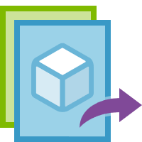
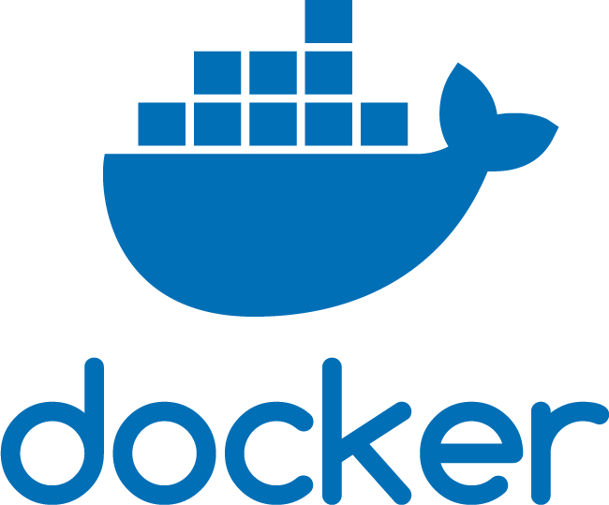
Docker in App Service on Linux
Testing/Staging on-premises
Production in Azure
Development on local machine
Container image
Notes:
App Service Linux provides predefined application stacks on Linux with support for languages such as .NET, PHP, Node.js, and others. These application stacks are defined by using Docker containers. You can also use a custom Docker image to run your web app on an application stack that is not already defined in Azure.
Using a Docker container for App Service can ensure that your applications remain portable and work in all your environments.

Slide 35
Web apps for Linux containers
Deploy applications and solutions that are containerized directly to App Service Web Apps
Simplifies deployment
Matches the already popular container workflow using:
CI/CD with Docker Hub, Azure Container Registry, or GitHub
Compatible with existing App Service features:
Auto-scale, Deployment Slots, and others
Notes:
Web App for Containers provides built-in Docker images on Linux with support for specific versions, such as PHP 7.0 and Node.js 4.5.
Web App for Containers uses the Docker container technology to host both built-in images and custom images as a Platform as a Service (PaaS).

Slide 36
Web apps for Linux containers (continued)
Containers can be sourced from your existing registries:
Docker Hub:
Deploy images already shared on Docker Hub
Deploy the most popular official images
Private images are available on Docker Hub
Azure Container Registry:
Managed service for hosting Docker images
Can deploy to Docker Swarm, Kubernetes, or Web App for Containers
Notes:
Custom image development requires basic knowledge of the Docker development workflow.
Deployment of a custom image to a web app requires publication of your custom image to a repository host like Docker Hub.
If you are familiar with Docker and can add Docker tasks to your build workflow, or if you are already publishing your app as a Docker image, a custom image is almost certainly the best choice.

Slide 37
Part 02: Azure SQL

Slide 38
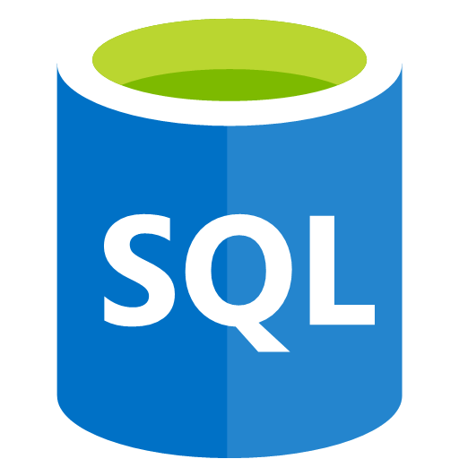

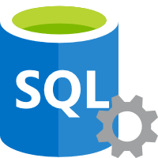
Azure SQL Database
Relational database managed service
Microsoft handles patching and updates
Shares code and features with SQL Server
Two purchasing models
vCore-based compute purchasing
DTU-based throughput purchasing
SQL Database
SQL Server
Notes:
SQL Database is a general-purpose relational database managed service in Microsoft Azure that supports structures such as relational data, JSON, spatial, and XML. SQL Database delivers dynamically scalable performance within two different purchasing models: a vCore-based purchasing model and a DTU-based purchasing model. SQL Database also provides options such as columnstore indexes for extreme analytic analysis and reporting, and in-memory OLTP for extreme transactional processing. Microsoft handles all patching and updating of the SQL code base seamlessly and abstracts away all management of the underlying infrastructure.
SQL Database shares its code base with the Microsoft SQL Server database engine. With the Microsoft cloud-first strategy, the newest capabilities of SQL Server are released first to SQL Database, and then to SQL Server itself. This approach provides you with the newest SQL Server capabilities with no overhead for patching or upgrading—and with these new features tested across millions of databases.

Slide 39

SQL Database Server and SQL Database
SQL Database server
Databases
Tabular data stream protocol
Notes:
Similar to SQL Server, the SQL Database service has two concepts in its hierarchy:
SQL Database server. An SQL Database server is a container for database instances. It provides the ability to establish sign-ins, create a firewall, and expose a tabular, data protocol endpoint. A server is required to create databases. Client devices will connect directly to your logical server in Azure.
SQL database. An SQL database is the implementation of an individual database by using the service, and it includes its tables and any other features.

Slide 40




Azure SQL Database deployment options
SQL Database
(Platform as a Service or PaaS)
Managed instance
Single
Elastic pool
Elastic Pool
Single
Elastic Pool
Managed Instance
Single
Managed Instance
Notes:
Azure SQL Database provides the following deployment options for an Azure SQL Database:
As a part of a collection of databases known as a managed instance that contains system and user databases and shared set of resources.
As a single database with its own set of resources managed via a logical server.
As a pooled database in an elastic pool with a shared set of resources managed via a logical server.

Slide 41
Choosing the right SQL option in Azure
SQL Server on a virtual machine (VM) | Azure SQL Database (Managed Instance) | Azure SQL Database (Logical server)
You have full control over the SQL Server engine Up to 99.95% availability Full parity with the matching version of on-premises SQL Server Fixed, well-known database engine version Easy migration from SQL Server on-premises Private IP address within Azure VNet You have the ability to deploy application or services on the host where SQL Server is placed | High compatibility with SQL Server on-premises 99.99% availability guaranteed Built-in backups, patching, recovery Latest stable Database Engine version Easy migration from SQL Server Private IP address within Azure VNet Built-in advanced intelligence and security Online change of resources (CPU/storage) | The most commonly used SQL Server features are available 99.99% availability guaranteed Built-in backups, patching, recovery Latest stable Database Engine version Ability to assign necessary resources (CPU/storage) to individual databases Built-in advanced intelligence and security Online change of resources (CPU/storage)
Notes:
In Azure, you can have your SQL Server workloads running in a hosted infrastructure (IaaS) or running as a hosted service (PaaS). The key question that you need to ask when deciding between PaaS or IaaS is this: Do you want to manage your database, apply patches, and take backups, or do you want to delegate these operations to Azure? Depending on the answer, you have the following options:
Azure SQL Database
A fully-managed SQL database engine, based on the latest stable Enterprise Edition of SQL Server. This is a relational database as a service (DaaS) hosted in the Azure cloud that falls into the industry category of platform as a service (PaaS). SQL Database is built on standardized hardware and software that is owned, hosted, and maintained by Microsoft. With SQL Database, you can use built-in features and functionality that require extensive configuration in SQL Server. When using SQL Database, you pay as you go, with options to scale up or out for greater power with no interruption. SQL Database has additional features that are not available in SQL Server, such as built-in intelligence and management. Azure SQL Database offers several deployment options:
You can deploy a single database to a logical server. A logical server containing single and pooled databases offers most of database-scoped features of SQL Server. This option is optimized for modern application development of new cloud-born applications.
You can deploy to a Azure SQL Database Managed Instances. With Azure SQL Database Managed Instance, Azure SQL Database offers shared resources for databases and additional instance-scoped features. Azure SQL Database Managed Instance supports database migration from on-premises with minimal to no database change. This option provides all of the PaaS benefits of Azure SQL Database but adds capabilities that were previously only available in SQL VMs. This includes a native virtual network (VNet) and near 100% compatibility with on-premises SQL Server.
SQL Server on Azure Virtual Machines
Infrastructure as a service (IaaS) that allows you to run SQL Server inside a fully managed virtual machine in the Azure cloud. SQL Server virtual machines also run on standardized hardware that is owned, hosted, and maintained by Microsoft. When using SQL Server on a VM, you can either pay as you go for a SQL Server license already included in a SQL Server image or easily use an existing license. You can also stop or resume the VM as needed. SQL Server is installed and hosted in the cloud on Windows Server or Linux virtual machines (VMs) running on Azure, also known as an infrastructure as a service (IaaS). SQL Server on Azure virtual machines is a good option for migrating on-premises SQL Server databases and applications without any database change. All recent versions and editions of SQL Server are available for installation in an IaaS virtual machine. The most significant difference from SQL Database is that SQL Server VMs allow full control over the database engine. You can choose: when maintenance/patching will start, to change the recovery model to simple or bulk logged to enable faster load less log, to pause or start engine when needed, and you can fully customize the SQL Server database engine. With this additional control comes with added responsibility to manage the virtual machines.

Slide 42
SQL option weaknesses
SQL Server on VM | Azure SQL Database (Managed Instance) | Azure SQL Database (Logical server)
You need to manage your backups and patches You need to implement your own high-availability solution There is downtime while changing the resources (CPU/storage) | There is still a minimal number of SQL Server features that are not available No guaranteed exact maintenance time (but nearly transparent) Compatibility with the SQL Server version can be achieved only by using database compatibility levels | Migration from SQL Server might be difficult Some SQL Server features are not available No guaranteed exact maintenance time (but nearly transparent) Compatibility with the SQL Server version can be achieved only by using database compatibility levels Private IP address cannot be assigned (you can limit the access using firewall rules)

Slide 43
Copying a SQL database
Copy
SQL database
SQL database
Notes:
Besides creating an SQL database, you can also copy an SQL database. The copy feature creates a transactionally-consistent copy of the SQL database and deploys the copy as a new instance.
This copy can be on the same server or a new server instance in Azure.

Slide 44
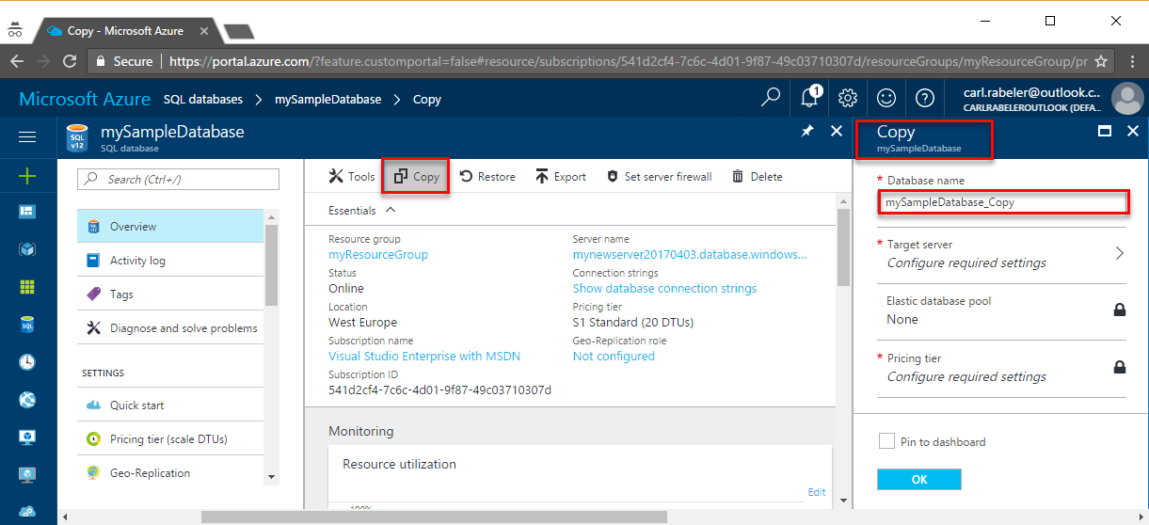
Copy an Azure SQL database - Azure portal
Notes:
A database copy is a snapshot of the source database as of the time of the copy request. You can select the same server or a different server, its service tier and compute size, or a different compute size within the same service tier (edition). After the copy is complete, it becomes a fully functional, independent database. At this point, you can upgrade or downgrade it to any edition. The logins, users, and permissions can be managed independently.
When you copy a database to the same logical server, the same logins can be used on both databases. The security principal that you use to copy the database becomes the database owner on the new database. All database users, their permissions, and their security identifiers (SIDs) are copied to the database copy. When you copy a database to a different logical server, the security principal on the new server becomes the database owner on the new database. If you use contained database users for data access, ensure that both the primary and secondary databases always have the same user credentials, so that after the copy is complete you can immediately access it with the same credentials.
After the new database is online on the destination server, use the ALTER USER statement to remap the users from the new database to logins on the destination server.

Slide 45
Copy an Azure SQL database – Azure PowerShell
New-AzSqlDatabaseCopy `
-ResourceGroupName "myResourceGroup" `
-ServerName $sourceserver `
-DatabaseName "MySampleDatabase" `
-CopyResourceGroupName "myResourceGroup" `
-CopyServerName $targetserver `
-CopyDatabaseName "CopyOfMySampleDatabase"
Notes:
To copy a database by using Azure PowerShell, use the New-AzSqlDatabaseCopy cmdlet..

Slide 46


Importing a .bacpac file
SQL database
.bacpac
Azure Storage
Notes:
If a database is persisted by using the .bacpac file format, you can import that file into the SQL database to create a new database instance. This process is referred to as importing a database.

Slide 47
Importing a .bacpac file - PowerShell
$importRequest = New-AzSqlDatabaseImport
-ResourceGroupName "<your_resource_group>" `
-ServerName "<your_server>" `
-DatabaseName "<your_database>" `
-DatabaseMaxSizeBytes "<database_size_in_bytes>" `
-StorageKeyType "StorageAccessKey" `
-StorageKey "<storage_access_key>"
-StorageUri "https://[account].blob.core.windows.net/example/demo.bacpac" `
-Edition "Standard" `
-ServiceObjectiveName "P6" `
-AdministratorLogin "<your_server_admin_account_user_id>" `
-AdministratorLoginPassword $(ConvertTo-SecureString –String `
"<your_server_admin_account_password>" -AsPlainText -Force)
Notes:
To import a .bacpac file by using PowerShell, use the New-AzSqlDatabaseImport cmdlet.

Slide 48
Exporting a .bacpac file
Check
Status
SQL database
.bacpac
Azure Storage
Notes:
To persist a point-in-time version of a database, you can export a database and save the database copy as a .bacpac file. Typically, this export is done to an Azure Storage account in an asynchronous (or job) manner. You can check on the status of a long-running export job.

Slide 49
Create a .bacpac export job - PowerShell
$exportRequest = New-AzSqlDatabaseExport `
-ResourceGroupName $ResourceGroupName `
-ServerName $ServerName `
-DatabaseName $DatabaseName `
-StorageKeytype $StorageKeytype `
-StorageKey $StorageKey `
-StorageUri $BacpacUri `
-AdministratorLogin $creds.UserName `
-AdministratorLoginPassword $creds.Password
Notes:
Create a new job to export a database in PowerShell by using the New-AzSqlDatabaseExport cmdlet.

Slide 50
Part 03: Azure Key Vault

Slide 51
Encryption at rest
Encryption (or encoding) of data when it is persisted
Very common security requirement to encrypt data with a secret encryption key anytime it is persisted to disk
Prevents attackers from accessing sensitive data when they have full access to a server’s machine, storage, or drives
Encryption at rest design in Azure uses symmetric encryption:
A symmetric encryption key is used to encrypt data as it is written to storage
The same encryption key is used to decrypt that data as it is readied for use in memory
Data may be partitioned, and different keys may be used for each partition
Keys are stored in a security-enhanced location with access-control policies
Data encryption keys are often encrypted with asymmetric encryption to further limit access
Notes:
Encryption at rest is the encoding (encryption) of data when it is persisted. It is a common security requirement for data that is persisted on disk to be encrypted with a secret encryption key. Encryption at rest helps provide data protection for stored data (at rest). Attacks against data at rest include attempts to obtain physical access to the hardware on which the data is stored and to then compromise the contained data. In such an attack, a server’s hard drive might have been mishandled during maintenance, allowing an attacker to remove the hard drive. Later, the attacker puts the hard drive into a computer under their control to attempts to access the data.
Encryption at rest is designed to prevent the attacker from accessing the unencrypted data by ensuring that the data is encrypted when on disk. If an attacker were to obtain a hard drive with such encrypted data but have no access to the encryption keys, the attacker would be unable to compromise the data without encountering great difficulty. In such a scenario, an attacker would have to attempt attacks against encrypted data, which are much more complex and resource consuming than accessing unencrypted data on a hard drive. For this reason, encryption at rest is highly recommended and is a high-priority requirement for many organizations.
Encryption at rest may also be required by an organization’s need for data governance and compliance efforts. Industry and government regulations, such as the Health Insurance Portability and Accountability Act (HIPAA), PCI DSS, and the Federal Risk and Authorization Management Program (FedRAMP), lay out specific safeguards regarding data protection and encryption requirements. Encryption at rest is a mandatory measure required for compliance with some of those regulations. In addition to meeting compliance and regulatory requirements, encryption at rest should be perceived as a defense-in-depth platform capability.

Slide 52




Encryption at rest in Azure
Azure Key Vault
Azure Active Directory
Key Encryption Keys (KEKs)
Data Encryption Keys (DEKs)
Resource providers
Notes:
Data encryption keys are often encrypted with asymmetric encryption to further limit access.

Slide 53

Encryption at rest for Azure services
Azure Storage
Data is automatically encrypted server-side for all Storage services (Blob, Queue, Table, Files)
By default, keys are managed by the service
Supports customer-managed keys stored in Azure Key Vault
Azure SQL Database
Transparent Data Encryption (TDE) is enabled by default on all new databases
Supports customer-managed 2048-bit keys stored in Azure Key Vault
Azure Cosmos DB
Backups and media attachments are stored in Blob storage
Databases are automatically encrypted on solid-state drives (SSDs)
Notes:
Azure Storage encryption
All Azure Storage services (Blob storage, Queue storage, Table storage, and Azure Files) support server-side encryption at rest, with some services supporting customer-managed keys and client-side encryption. All Azure Storage services enable server-side encryption by default by using service-managed keys, which are transparent to the application.
Storage Service Encryption is enabled for all new and existing storage accounts and cannot be disabled. Because your data is security enhanced by default, you don't need to modify your code or applications to take advantage of Storage Service Encryption.
Note that Azure Storage supports the use of customer-managed keys stored in Azure Key Vault.
Azure SQL Database encryption
Azure SQL Database supports encryption at rest for Microsoft-managed server-side and client-side encryption scenarios. Support for server encryption is currently provided through the unified SQL feature called Transparent Data Encryption (TDE). After an Azure SQL Database customer enables TDE, keys are automatically created and managed for them. Encryption at rest can be enabled at the database and server levels. TDE is enabled by default on newly created databases. Azure SQL Database also supports RSA 2048-bit customer-managed keys in Azure Key Vault.
Azure Cosmos DB encryption
Cosmos DB stores its primary databases on solid-state drives (SSDs). Its media attachments and backups are stored in Azure Blob storage, which is generally backed up by hard disk drives (HDDs). Cosmos DB automatically encrypts all databases, media attachments and backups.

Slide 54





Transparent Data Encryption (TDE)
Encrypts database, backups, and logs at rest and in flight
Requires little to no code changes
Only requires a modification to connection string in most scenarios
Can be used with many third-party SQL tools already in the market
Supported in Microsoft Azure SQL Database, Azure SQL Data Warehouse, and SQL Server
User writing
to
application
Azure SQL Database
TDE enabled
database
Wrapped Database
Encryption Key (DEK)
Notes:
Explain that TDE uses a Database Encryption Key (DEK), which is stored in the database boot record for availability during recovery. The DEK is either a symmetric key secured by using a certificate stored in the master database of the server or an asymmetric key protected by an Extensible Key Management (EKM) module. TDE protects data at rest, meaning the data and log files. It provides the ability to comply with many laws, regulations, and guidelines established in various industries. This enables software developers to encrypt data by using the AES and 3DES encryption algorithms without changing existing applications.

Slide 55

Always Encrypted
Apps
Fully transparent encryption
Encrypted inside client applications
Encryption keys are not available to the
database engine
Encrypts data at rest, in flight, and in memory
Requires the use of specific drivers
In most applications, requires some rewrites
Not compatible with every third-party tool
Trusted
Query
Enhanced
ADO.NET
Library
Column
Master Key
SQL Server
Column
Encryption Key
Notes:
Always Encrypted is a feature designed to protect sensitive data, such as credit card numbers or national identification numbers (for example, United States Social Security numbers), stored in Azure SQL Database or SQL Server databases. Always Encrypted allows clients to encrypt sensitive data inside client applications and never reveal the encryption keys to the database engine (SQL Database or SQL Server). As a result, Always Encrypted provides a separation between those who own the data (and can view it) and those who manage the data (but should have no access). After you encrypt the data, only client applications or app servers that have access to the keys can access the plaintext data.
Emphasize that Always Encrypted requires a specialized driver installed on the client computer to automatically encrypt and decrypt sensitive data in the client application. For many applications, this does require some code changes. This is in contrast to TDE, which only requires a change to the application’s connection string.

Slide 56
Trusted Execution Environments
Data is processed within Trusted Execution Environments (TEEs)
Ensures that there is no way to view data or operations inside the TEE from the outside
If code is tampered with or altered, all operations are halted, and the environment is disabled
TEEs can be hardware based or software based
Many Azure services, such as Azure SQL Database, execute code in TEEs
There are frameworks available to take advantage of TEEs
Example: Confidential Consortium Blockchain Framework
TEEs are being developed through collaboration among vendors:
Intel (SGX)
Microsoft Research
Notes:
The goal of confidential computing is to build a platform where developers can take advantage of both hardware and software without being required to change application code. TEEs are exposed in multiple ways:
Hardware – Intel Xeon processors with Intel SGX technology are available for Azure Virtual Machines.
Software – The Intel SGX software development kit (SDK) and third-party enclave APIs can be used with compute instances and Virtual Machines in Azure.
Services – Many Azure services, such as Azure SQL Database, already execute code in TEEs.
Frameworks – The Microsoft Research team has developer frameworks, such as the Confidential Consortium Blockchain Framework, to help start new projects that need to run in TEEs.
Point out that TEEs are also commonly referred to as enclaves.

Slide 57
Azure confidential computing
Data at rest (BitLocker)
Based on trusted execution enclaves:
Virtualization-based security
Intel® Software Guard Extensions (Intel® SGX)
Secures all data while in use:
Workloads are invisible to host fabric
Data is now always encrypted
Protected while in use, in transit, and in storage
Protects against multiple threats:
Malicious insiders, including admins, hackers and malware
Third-party access without consent
Data in use (trusted execution environments)
Data in transit (SSL, TLS)
Notes:
Confidential computing adds new data security capabilities by using trusted execution environments or encryption mechanisms to protect your data while in use. Trusted execution environments are hardware or software implementations that protect the data from being accessed by any entity outside the execution environment.
When no longer in use, confidential computing stores the data "at rest" in a secure manner by using BitLocker. To transfer the data to another Azure service, confidential computing uses Secure Sockets Layer (SSL) or Transport Layer Security (TLS).

Slide 58


Azure Key Vault
Administrator with Azure subscription
creates and manages the vault and keys
Safeguard cryptographic keys and other secrets that cloud apps and services use
Increase security and control over keys and passwords
Applications have no direct access to keys
Use FIPS 140-2 Level 2 validated hardware security modules (HSMs)
Create and import
Encryption keys
API keys
Secrets
Passwords
SSL/TLS certificates
Azure Key Vault
Usage logging for keys
URIs for keys
Security administrator
Azure developer
Notes:
Azure Key Vault is a cloud service that works as a security-enhanced secrets store.
Key Vault allows you to create multiple security-enhanced containers, called vaults. These vaults are backed by hardware security modules (HSMs). Vaults help to reduce the chance of accidentally losing security information by centralizing the storage of application secrets. Vaults also control and log the access to anything stored in them. Azure Key Vault is designed to support any type of secret, such as a password, database credential, API key, or certificate. Software or HSMs can help to protect these secrets. Azure Key Vault can handle requesting and renewing Transport Layer Security (TLS) certificates, providing the features required for a robust certificate lifecycle management solution.
Key Vault streamlines the key management process and enables you to maintain control of keys that access and encrypt your data. Developers can create keys for development and testing in minutes, and then seamlessly migrate them to production keys. Security administrators can grant (and revoke) permission to keys as needed.

Slide 59

Key Vault secret types
Certificates
Azure Storage
Cryptographic keys
Secrets
Notes:
Key Vault enables Microsoft Azure applications and users to store and use several types of secret/key data, including:
Cryptographic keys. Key Vault supports multiple key types and algorithms and using hardware security modules (HSMs) for high-value keys.
Secrets. Key Vault provides secure storage of secrets, such as passwords and database connection strings.
Certificates. Key Vault supports certificates, which are built on top of keys and secrets, and add an automated renewal feature.
Azure Storage. Key Vault can manage the keys of an Azure Storage account. Internally, Key Vault can list (sync) keys with an Azure Storage Account and regenerate (rotate) the keys periodically.

Slide 60
Create Key Vault secret by using Azure CLI
# Create resource group
az group create --name SecurityGroup --location westus
# Create Key Vault resource
az keyvault create --name contosovault --resource-group SecurityGroup --location westus
# Set secret in Key Vault
az keyvault secret set --vault-name contosovault --name DatabasePassword --value 'Pa5w.rd’
# Show value of secret in Key Vault
az keyvault secret show --vault-name contosovault --name DatabasePassword
Notes:
This sample script shows how you can create a Resource Group and Azure Key Vault resource.
Once created, the script creates and then retrieves a secret named DatabasePassword in the Key Vault resource.

Slide 61
Part 04: Azure Cosmos DB

Slide 62


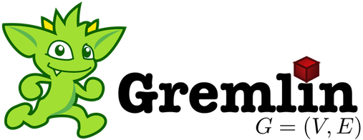


Azure Cosmos DB
Table API
LEAF}
MongoDB
Column-family
Document
Key-value
Graph
Guaranteed low latency at the 99th percentile
Elastic scale-out
of storage and throughput
Five well-defined consistency models
Turnkey global distribution
Comprehensive Service Level Agreements
Notes:
Microsoft Azure Cosmos DB is a database service native to Azure that focuses on providing a high-performance database regardless of your selected API or data model. Azure Cosmos DB offers multiple APIs and models that can be used interchangeably for various application scenarios.

Slide 63
Core functionality
Global replication
Automatic and synchronous multi-region replication
Supports automatic and manual failover
Varied consistency levels
Offers five consistency models
Provides control over performance-consistency tradeoffs, backed by comprehensive SLAs
Low latency
Serve <10 ms read and <15 ms write requests at the 99th percentile
Elastic scale-out
Elastically scale throughput from 10 to 100s of millions of requests/sec across multiple regions
Support for requests/sec for different workloads
Notes:
Azure Cosmos DB has four core features that are the same regardless of which API you use.

Slide 64
Global Replication
Turnkey global distribution automatically replicates data to other Azure datacenters across the globe without the need to manually write code or build a replication infrastructure
Notes:
Azure Cosmos DB has a feature referred to as turnkey global distribution that automatically replicates data to other Azure datacenters across the globe without the need to manually write code or build a replication infrastructure.

Slide 65
Consistency levels
Azure Cosmos DB provides five consistency levels:
v
Strong
Bounded-stateless
Session
Consistent prefix
Eventual
Notes:
Azure Cosmos DB provides five consistency levels: strong, bounded-stateless, session, consistent prefix, and eventual. Bounded-stateless, session, consistent prefix, and eventual are referred to as relaxed consistency models, because they provide less consistency than strong, which is the most highly consistent model available.
Commercial distributed databases fall into two categories: databases that do not offer well-defined, provable consistency choices at all, and databases that offer two extreme programmability choices (strong versus eventual consistency). The former burdens application developers with the minutia of their replication protocols and expects them to make difficult tradeoffs among consistency, availability, latency, and throughput. The latter pressure them to choose one of the two extremes.

Slide 66
Consistency levels
Consistency Level | Description
Strong | When a write operation is performed on your primary database, the write operation is replicated to the replica instances. The write operation is committed (and visible) on the primary only after it has been committed and confirmed by all replicas.
Bounded Stateless | This level is similar to the Strong level with the major difference that you can configure how stale documents can be within replicas. Staleness refers to the quantity of time (or the version count) a replica document can be behind the primary document.
Session | This level guarantees that all read and write operations are consistent within a user session. Within the user session, all reads and writes are monotonic and guaranteed to be consistent across primary and replica instances.
Consistent Prefix | This level has loose consistency but guarantees that when updates show up in replicas, they will show up in the correct order (that is, as prefixes of other updates) without any gaps.
Eventual | This level has the loosest consistency and essentially commits any write operation against the primary immediately. Replica transactions are asynchronously handled and will eventually (over time) be consistent with the primary. This tier has the best performance, because the primary database does not need to wait for replicas to commit to finalize it's transactions.
Notes:
The consistency levels range from very strong consistency—where reads are guaranteed to be visible across replicas before a write is fully committed across all replicas—to eventual consistency, where writes are readable immediately, and replicas are eventually consistent with the primary.

Slide 67


APIs
MongoDB API
Acts as a massively scalable MongoDB service powered by the Azure Cosmos DB platform
Compatible with existing MongoDB libraries, drivers, tools, and applications
Table API
A key-value database service built to provide premium capabilities to existing Azure Table storage applications without making any app changes
Gremlin API
A fully managed, horizontally scalable graph database service
Easy-to-build and run applications that work with highly connected datasets supporting Open Graph APIs (based on the Apache TinkerPop specification, Apache Gremlin)
Notes:
Today, Azure Cosmos DB can be accessed by using five different APIs. The underlying data structure in Azure Cosmos DB is a data model based on atom record sequences that enabled Azure Cosmos DB to support multiple data models. Because of the flexible nature of atom record sequences, Azure Cosmos DB will be able to support many more models and APIs over time.
MongoDB API
The MongoDB API in Azure Cosmos DB acts as a massively scalable MongoDB service powered by the Azure Cosmos DB platform. It is compatible with existing MongoDB libraries, drivers, tools, and applications.
Table API
The Table API in Azure Cosmos DB is a key-value database service built to provide premium capabilities (for example, automatic indexing, guaranteed low latency, and global distribution) to existing Azure Table storage applications without making any app changes.
Gremlin API
The Gremlin API in Azure Cosmos DB is a fully managed, horizontally scalable graph database service that makes it easy to build and run applications that work with highly connected datasets supporting Open Graph APIs (based on the Apache TinkerPop specification, Apache Gremlin).

Slide 68

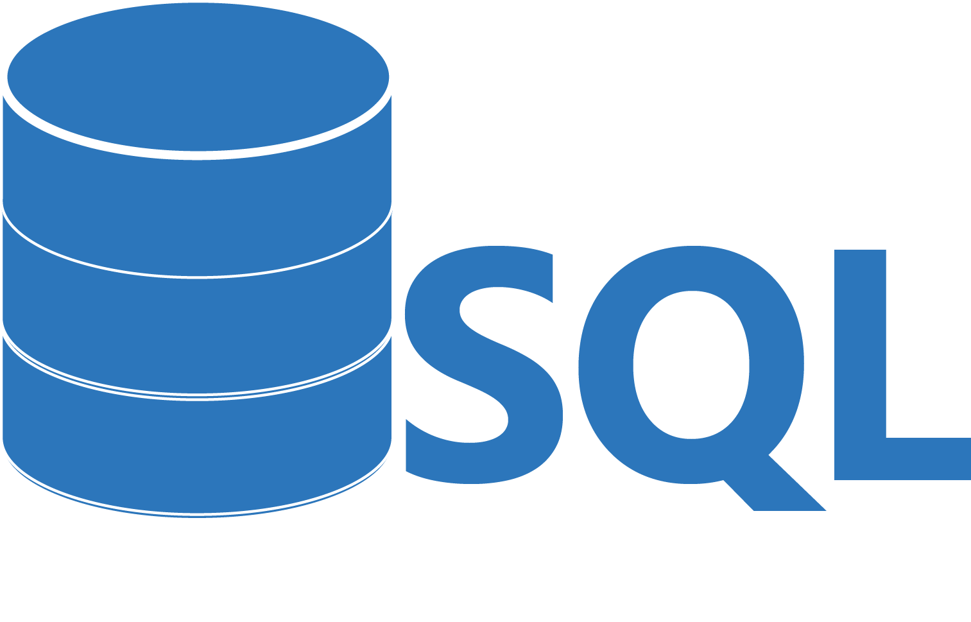
APIs (cont.)
Cassandra API
Globally distributed Apache Cassandra service powered by the Azure Cosmos DB platform
Compatible with existing Apache Cassandra libraries, drivers, tools, and applications
SQL API
JavaScript and JavaScript Object Notation (JSON) native API based on the Azure Cosmos DB database engine
Provides query capabilities rooted in SQL
Query for documents based on their identifiers or make deeper queries based on properties of the document, complex objects, or the existence of specific properties
Supports the execution of JavaScript logic within the database in the form of stored procedures, triggers, and user-defined functions
Notes:
Apache Cassandra API
The Cassandra API in Azure Cosmos DB is a globally distributed Apache Cassandra service powered by the Azure Cosmos DB platform. Compatible with existing Apache Cassandra libraries, drivers, tools, and applications.
SQL API
The SQL API in Azure Cosmos DB is a JavaScript and JavaScript Object Notation (JSON) native API based on the Azure Cosmos DB database engine. The SQL API also provides query capabilities rooted in the familiar SQL query language. By using SQL, you can query for documents based on their identifiers or make deeper queries based on properties of the document, complex objects, or even the existence of specific properties. The SQL API supports the execution of JavaScript logic within the database in the form of stored procedures, triggers, and user-defined functions.

Slide 69
Consistency levels and Azure Cosmos DB APIs
Apache Cassandra
MongoDB (3.4)
Apache Cassandra 4.x | Azure Cosmos DB (multi-region) | Azure Cosmos DB (single region)
ONE, TWO, THREE | Consistent prefix | Consistent prefix
LOCAL_ONE | Consistent prefix | Consistent prefix
QUORUM, ALL, SERIAL | Bounded stateless | Strong
LOCAL_QUORUM | Bounded stateless | Strong
LOCAL_SERIAL | Bounded stateless | Strong
MongoDB 3.4 | Azure Cosmos DB (multi-region) | Azure Cosmos DB (single region)
Linearizable | Strong | Strong
Majority | Bounded staleness | Strong
Local | Consistent prefix | Consistent prefix
Notes:
Five consistency models offered by Azure Cosmos DB are natively supported by the Azure Cosmos DB SQL API. When you use Azure Cosmos DB, the SQL API is the default.
Azure Cosmos DB also provides native support for wire protocol-compatible APIs for popular databases. Databases include MongoDB, Apache Cassandra, Gremlin, and Azure Table storage. These databases don't offer precisely defined consistency models or SLA-backed guarantees for consistency levels. They typically provide only a subset of the five consistency models offered by Azure Cosmos DB. For the SQL API, Gremlin API, and Table API, the default consistency level configured on the Azure Cosmos DB account is used.

Slide 70
Migrating from NoSQL
Many NoSQL database engines are simple to get started with, but they might cause problems as you scale, including:
Tedious setup and maintenance requirements for a multiple-server database cluster
Expensive and complex high-availability solutions
Challenges in achieving end-to-end security, including encryption at rest and in flight
Required resource overprovisioning and unpredictable costs to achieve scale
Azure Cosmos DB provides NoSQL-as-a-service for:
MongoDB
Cassandra
Gremlin
Notes:
To achieve a successful migration, it is important to keep a few tips in mind:
Instead of writing custom code, you should use native tools, such as the Cassandra shell, mongodump, and mongoexport.
Azure Cosmos DB containers should be allocated prior to the migration with the appropriate throughput levels set. Many of the tools will create containers for you with default settings that are not ideal.
Prior to migrating, you should increase the container’s throughput to at least 1,000 Request Units (RUs) per second so that the import tools are not throttled. The throughput can be reverted back to the typical values after the import is complete.

Slide 71
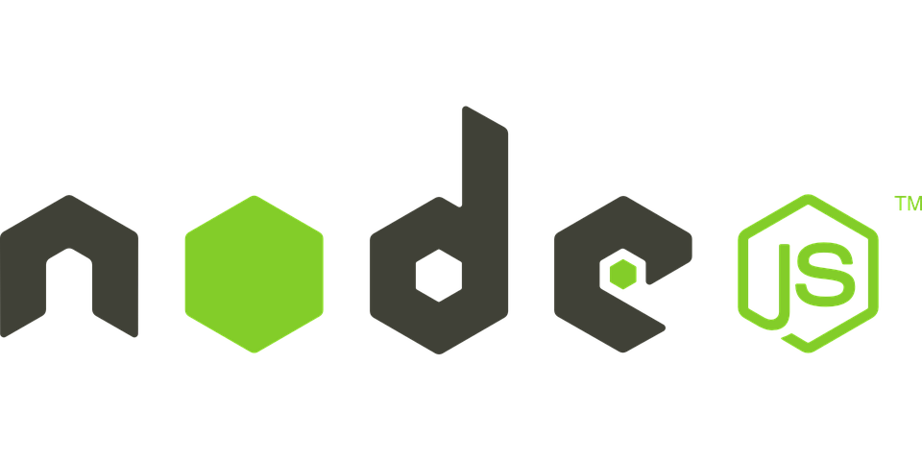


Migrating from NoSQL
NoSQL wire protocol
MongoDB
Azure Cosmos DB MongoDB API
NoSQL wire protocol
Azure Cosmos DB Cassandra API
Notes:
Azure Cosmos DB has a MongoDB API and a Cassandra API to provide a NoSQL service offering for two of the most popular NoSQL database platforms. Both APIs are protocol compatible with the Cassandra API supporting CQLv4 and the MongoDB API supporting MongoDB v5. Many applications can be “lifted and shifted” to Azure Cosmos DB without the need to rewrite code.

Slide 72
Resource hierarchy
Account
Database
Database
Database
Database
=
Database
Container
Collection
Graph
Table
Database
Database
Sproc
Trigger
User-defined function
Conflict
Item
Notes:
The JSON documents stored in the Azure Cosmos DB SQL API are managed through a well-defined hierarchy of database resources. The Azure Cosmos DB hierarchical resource model consists of sets of resources under a database account, each addressable via a logical and stable URI. A set of resources is referred to as a feed.

Slide 73
Resource hierarchy (continued)
Resource | Description
Account | A set of databases
Database | Logical container for containers that can (optionally) share throughput across the containers
Collection (container) | A group of Items and programmatic resources usually related in some way
Document (item) | An arbitrary unit of content In many cases, this would be a JSON document
Stored procedure (sproc) | Application logic written in JavaScript executed within the database engine as a transaction
Trigger | Application logic written in JavaScript executed before or after either an insert, replace, or delete operation
User-defined function | Application logic written in JavaScript to extend the SQL API query language
Notes:
Account
A database account is associated with a set of databases and a fixed amount of large object (blob) storage for attachments. You can create one or more database accounts by using your Azure subscription.
Database
A database is a logical container of document storage partitioned across collections. It is also a users container.
Collection (container)
A collection is a container of JSON documents and the associated JavaScript application logic. Collections can span one or more partitions or servers and can scale to handle practically unlimited volumes of storage or throughput.
Document (item)
User-defined (arbitrary) JSON content. By default, no schema needs to be defined, nor do secondary indexes need to be provided for all the documents added to a collection.
Stored procedure (sproc)
Application logic written in JavaScript that is registered with a collection and executed within the database engine as a transaction.
Trigger
Application logic written in JavaScript executed before or after either an insert, replace, or delete operation.
User-defined function
Application logic written in JavaScript. User-defined functions enable you to model a custom query operator and thereby extend the core SQL API query language.

Slide 74



Containers
Database
500 RU/s
5000 RU/s
2000 RU/s
Containers
Notes:
In the Azure Cosmos DB SQL API, databases are essentially containers for collections. Collections are where you place individual documents. A collection is intrinsically elastic—it automatically grows and shrinks as you add or remove documents.
Each collection is assigned a throughput value, and that value dictates the maximum throughput for that collection and its corresponding documents. Alternatively, you can assign the throughput at the database level and share the throughput values among the collections in the database. If you have a set of documents that needs throughput beyond the limits of an individual collection, you can distribute the documents among multiple collections. Each collection has its own distinct throughput level.
If a particular collection is seeing spikes in throughput, you can manage its throughput level in isolation by increasing or decreasing the value. This change to the throughput level of a particular collection will not cause side effects for the other collections. This allows you to adjust to meet the performance needs of any workload in isolation.
You can also scale workloads across collections, if you have a workload that needs to be partitioned, you can scale that workload by distributing its associated documents across multiple collections. The SQL API for Azure Cosmos DB includes a client-side partition resolver that allows you to manage transactions and point them in code to the correct partition based on a partition key field.

Slide 75



Partitioning
Sharding logic:
Route requests for tenant 1 to shard …
…
Route request for tenant 44 to shard A
…
Route requests for tenant 227 to shard C
…
Route request for tenant N to shard …
Application instance
Application instance
Query: Find information for tenant 55
Query: Find information for tenant 27
. . .
Partition A
Partition B
Partition C
Partition N
Notes:
Azure Cosmos DB provides containers for storing data called collections (for documents), graphs, or tables. Containers are logical resources and can span one or more physical partitions or servers. The number of partitions is determined by Azure Cosmos DB based on the storage size and throughput provisioned for a container or set of containers.
If you are already familiar with the sharding pattern, the idea of dynamic partitioning is not very different.
A physical partition is a fixed amount of reserved solid-state drive (SSD) back-end storage combined with a variable amount of compute resources (CPU and memory). Each physical partition is replicated for high availability. A physical partition is an internal concept of Azure Cosmos DB, and physical partitions are transient. Azure Cosmos DB will automatically scale the number of physical partitions based on your workload.

Slide 76
Partitioning implementation
Partition Key: User ID
Azure Cosmos DB Container (for example, Collection)
Logical Partitioning Abstraction
Behind the scenes:
Physical partition sets
hash(User ID)
Psuedo-random distribution of data over the range of possible hashed values
Dharma
Andrew
…
Shireesh
Karthik
Mike
Bob
Rimma
…
Alice
…
Carol
Partition 1
Partition 2
Partition n
Frugal number of partitions based on actual storage and throughput needs
Notes:
A logical partition is a partition within a physical partition that stores all the data associated with a single partition key value. Partition ranges can be dynamically subdivided to seamlessly grow the database as the application grows while simultaneously maintaining high availability. When a container meets the partitioning prerequisites, partitioning is completely transparent to your application. Azure Cosmos DB handles distributing data across physical and logical partitions and routing query requests to the right partition.

Slide 77


JavaScript and Azure Cosmos DB
Stored procedures
User-defined functions
Triggers (pre/post)
Azure Cosmos DB
Notes:
JavaScript is the primary language for creating server-side logic for Azure Cosmos DB databases and can be used to write:
Stored procedures.
User-defined functions.
Triggers (pre/post).
The next set of slides will use examples of each programmatic feature. Let’s understand stored procedures first.

Slide 78

Stored procedures
In Azure Cosmos DB, JavaScript is hosted in the same memory space as the database
Requests made within stored procedures and triggers run in the same scope of a database session
Create new
document
Query collection
Update existing document
Delete existing document
Notes:
In a typical database, a transaction can be defined as a sequence of operations that are performed as a single, logical unit of work. Each transaction provides atomicity, consistency, isolation, and durability (ACID) guarantees. Let’s understand ACID in some detail.
ACID:
Atomicity guarantees that all the work done inside a transaction is treated as a single unit where either all of it is committed or none is.
Consistency makes sure that the data is always in a good internal state across transactions.
Isolation guarantees that no two transactions interfere with each other. Generally, most commercial systems provide multiple isolation levels that can be used as per the application needs.
Durability ensures that any change that is committed in the database will always be present.
Because requests made within stored procedures and triggers run in the same scope of a database session, the services guarantee ACID for all operations that are part of a single stored procedure trigger.
This diagram illustrates the process of running a stored JavaScript procedure on Azure Cosmos DB servers and common tasks that might run within the stored procedures’ scoped transaction, such as creating, querying, updating, or deleting documents.

Slide 79
Stored procedure in JavaScript
function createSampleDocument(documentToCreate) {
var context = getContext();
var collection = context.getCollection();
var accepted = collection.createDocument(
collection.getSelfLink(),
documentToCreate,
function (error, documentCreated) {
context.getResponse().setBody(documentCreated.id)
}
);
if (!accepted) return;
}
Notes:
This stored procedure takes an input parameter named documentToCreate. In this example, the parameter’s value is the body of a document to be created in the current collection.
All operations are asynchronous and depend on JavaScript function callbacks. The callback function has two parameters:
One for the error object in case the operation fails.
One for the created object.
Inside the callback, users can either handle the exception or throw an error. In case a callback isn’t provided and there’s an error, the Azure Cosmos DB runtime throws an error.
In the example on the slide, the callback throws an error if the operation fails. Otherwise, it sets the id of the created document as the body of the response to the client.

Slide 80
Bounded execution
All Azure Cosmos DB operations must complete within a limited amount of time
Specifically, stored procedures have a limited amount of time to run on the server
All collection functions return a Boolean value that represents whether that operation will complete or not
True (Will complete)
Function <>
False (Roll back)
Notes:
All Azure Cosmos DB operations must complete within the server-specified request timeout duration.
If an operation doesn’t complete within this time limit, the transaction is rolled back.
All functions under the collection object (for create, read, replace, and delete documents and attachments) return a Boolean value that represents whether that operation will complete or not.
Next, let’s understand transaction continuation.

Slide 81
Transaction continuation
JavaScript functions can implement a continuation-based model to batch or resume execution
The continuation value can be any value of your choice
Your applications can then use this value to resume a transaction from a new starting point
Notes:
Functions can return any value. You can use this value to resume long-running functions after the server-specified time is over. For example, you might have a function to upload millions of documents. If the server-specified time is over before all documents upload, you can return a pointer to indicate how far your function progressed in the document upload. This will make it easier to resume processing in a new function iteration. The next slide depicts this with another example in a flow diagram.

Slide 82
Transaction continuation (cont.)
Bulk create documents
Each document
Try create
Observe
return
value
Done
Return a pointer to resume later
Notes:
This diagram depicts how the transaction continuation model can be used to repeat a server-side function until the function finishes its entire processing workload.
In this example, after the workflow begins, the return value is observed as each document is created. At some point, the document creation method will return false instead of true. At this point, a pointer will immediately be returned to the client that originally invoked the function. The client will then resume the function by starting at the appropriate point in the list of documents to process.

